Slide 1



Through the Data Management Lens: Experimental Analysis and Evaluation of Fair Classification
Maliha T Islam¹ Anna Fariha² Alexandra Meliou¹ Babak Salimi³
¹University of Massachusetts Amherst ²Microsoft ³University of California, San Diego
Notes:
Hi everyone, I’m Maliha from UMass Amherst.
Today I’ll talk about my work, which is an experimental analysis of fair classification methods.
What I mean by that is, we’ll look at existing fair classification methods and reevaluate them from a data management perspective.
This is a joint work with Anna Fariha, Alexandra Meliou and Babak Salimi.

Slide 2
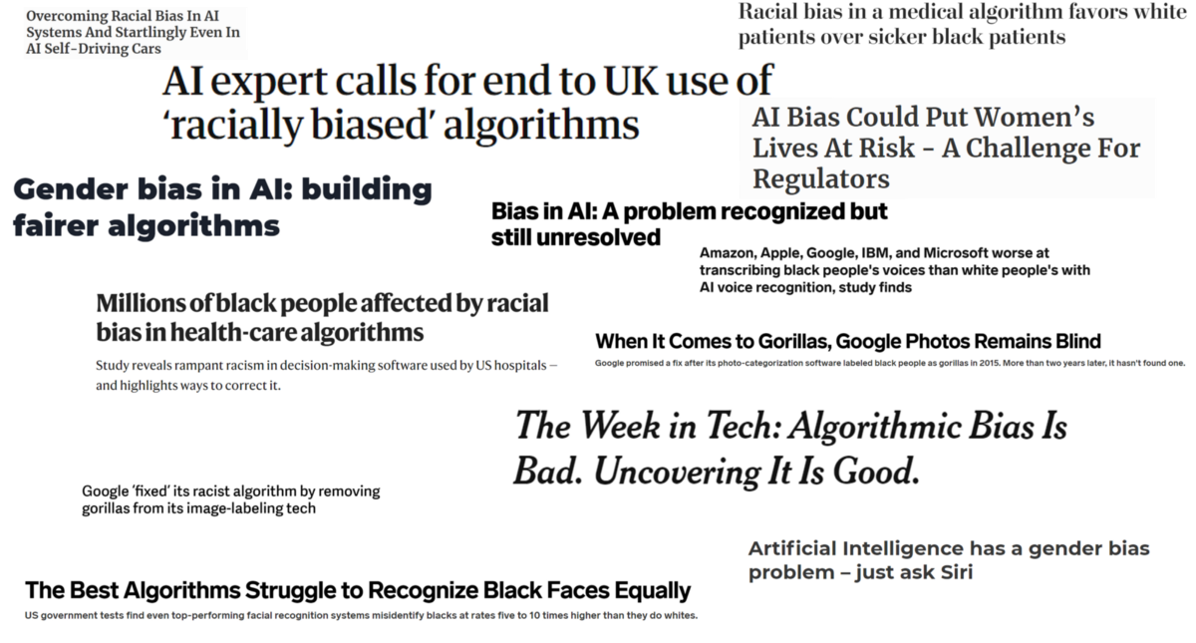
Machine learning systems often demonstrate discriminatory behavior
Notes:
A lot of our daily activities rely on machine learning systems- systems that generate predictions.
For example, a credit card application predicts if an applicant is creditworthy.
The problem with these systems is that they can be discriminatory, especially wrt race or gender.
As data management researchers, this is relevant to us because biases are often learned from historical data that these systems depend on.

Slide 3
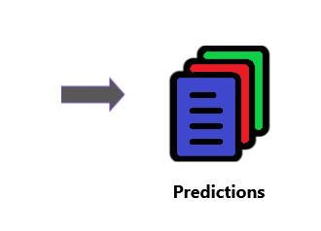
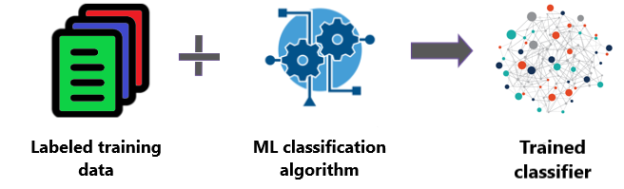
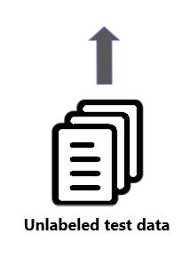
Classification, a machine learning task, is susceptible to similar kinds of biases
Notes:
Classification is one type of ML problem.
Simply put, it is a task of predicting which class or category a datapoint belongs to.
A ML algorithm learns patterns from labeled training data, so that when we feed unlabeled data, it can accurately predict the label for these new datapoints.

Slide 4
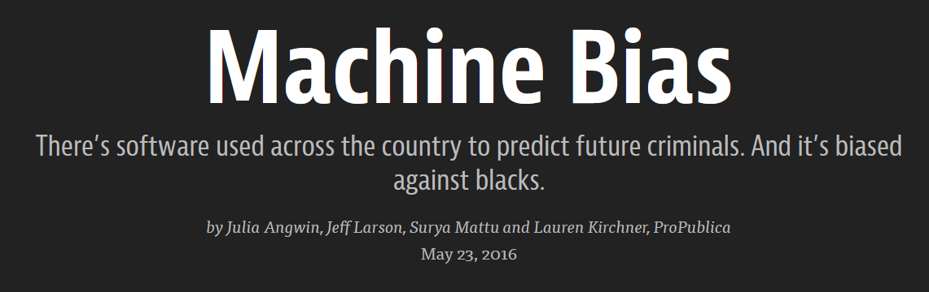
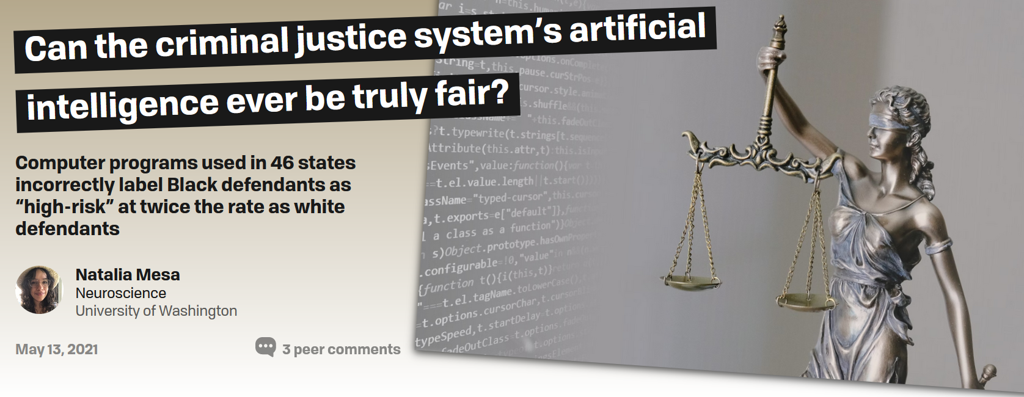
Classification, a machine learning task, is susceptible to similar kinds of biases
Case in point: COMPAS recidivism tool
Notes:
Since classification is a data-driven task, it is vulnerable to biases as well.
For example, the US courts use a tool called COMPAS to predict if a defendant is likely to commit another crime in future.
An investigation in 2016 revealed that COMPAS is racially biased-
a black defendant is twice more likely to be labeled “high-risk” even though they are actually not.
And unfortunately, COMPAS is just one of many reported incidents of classifier biases.

Slide 5
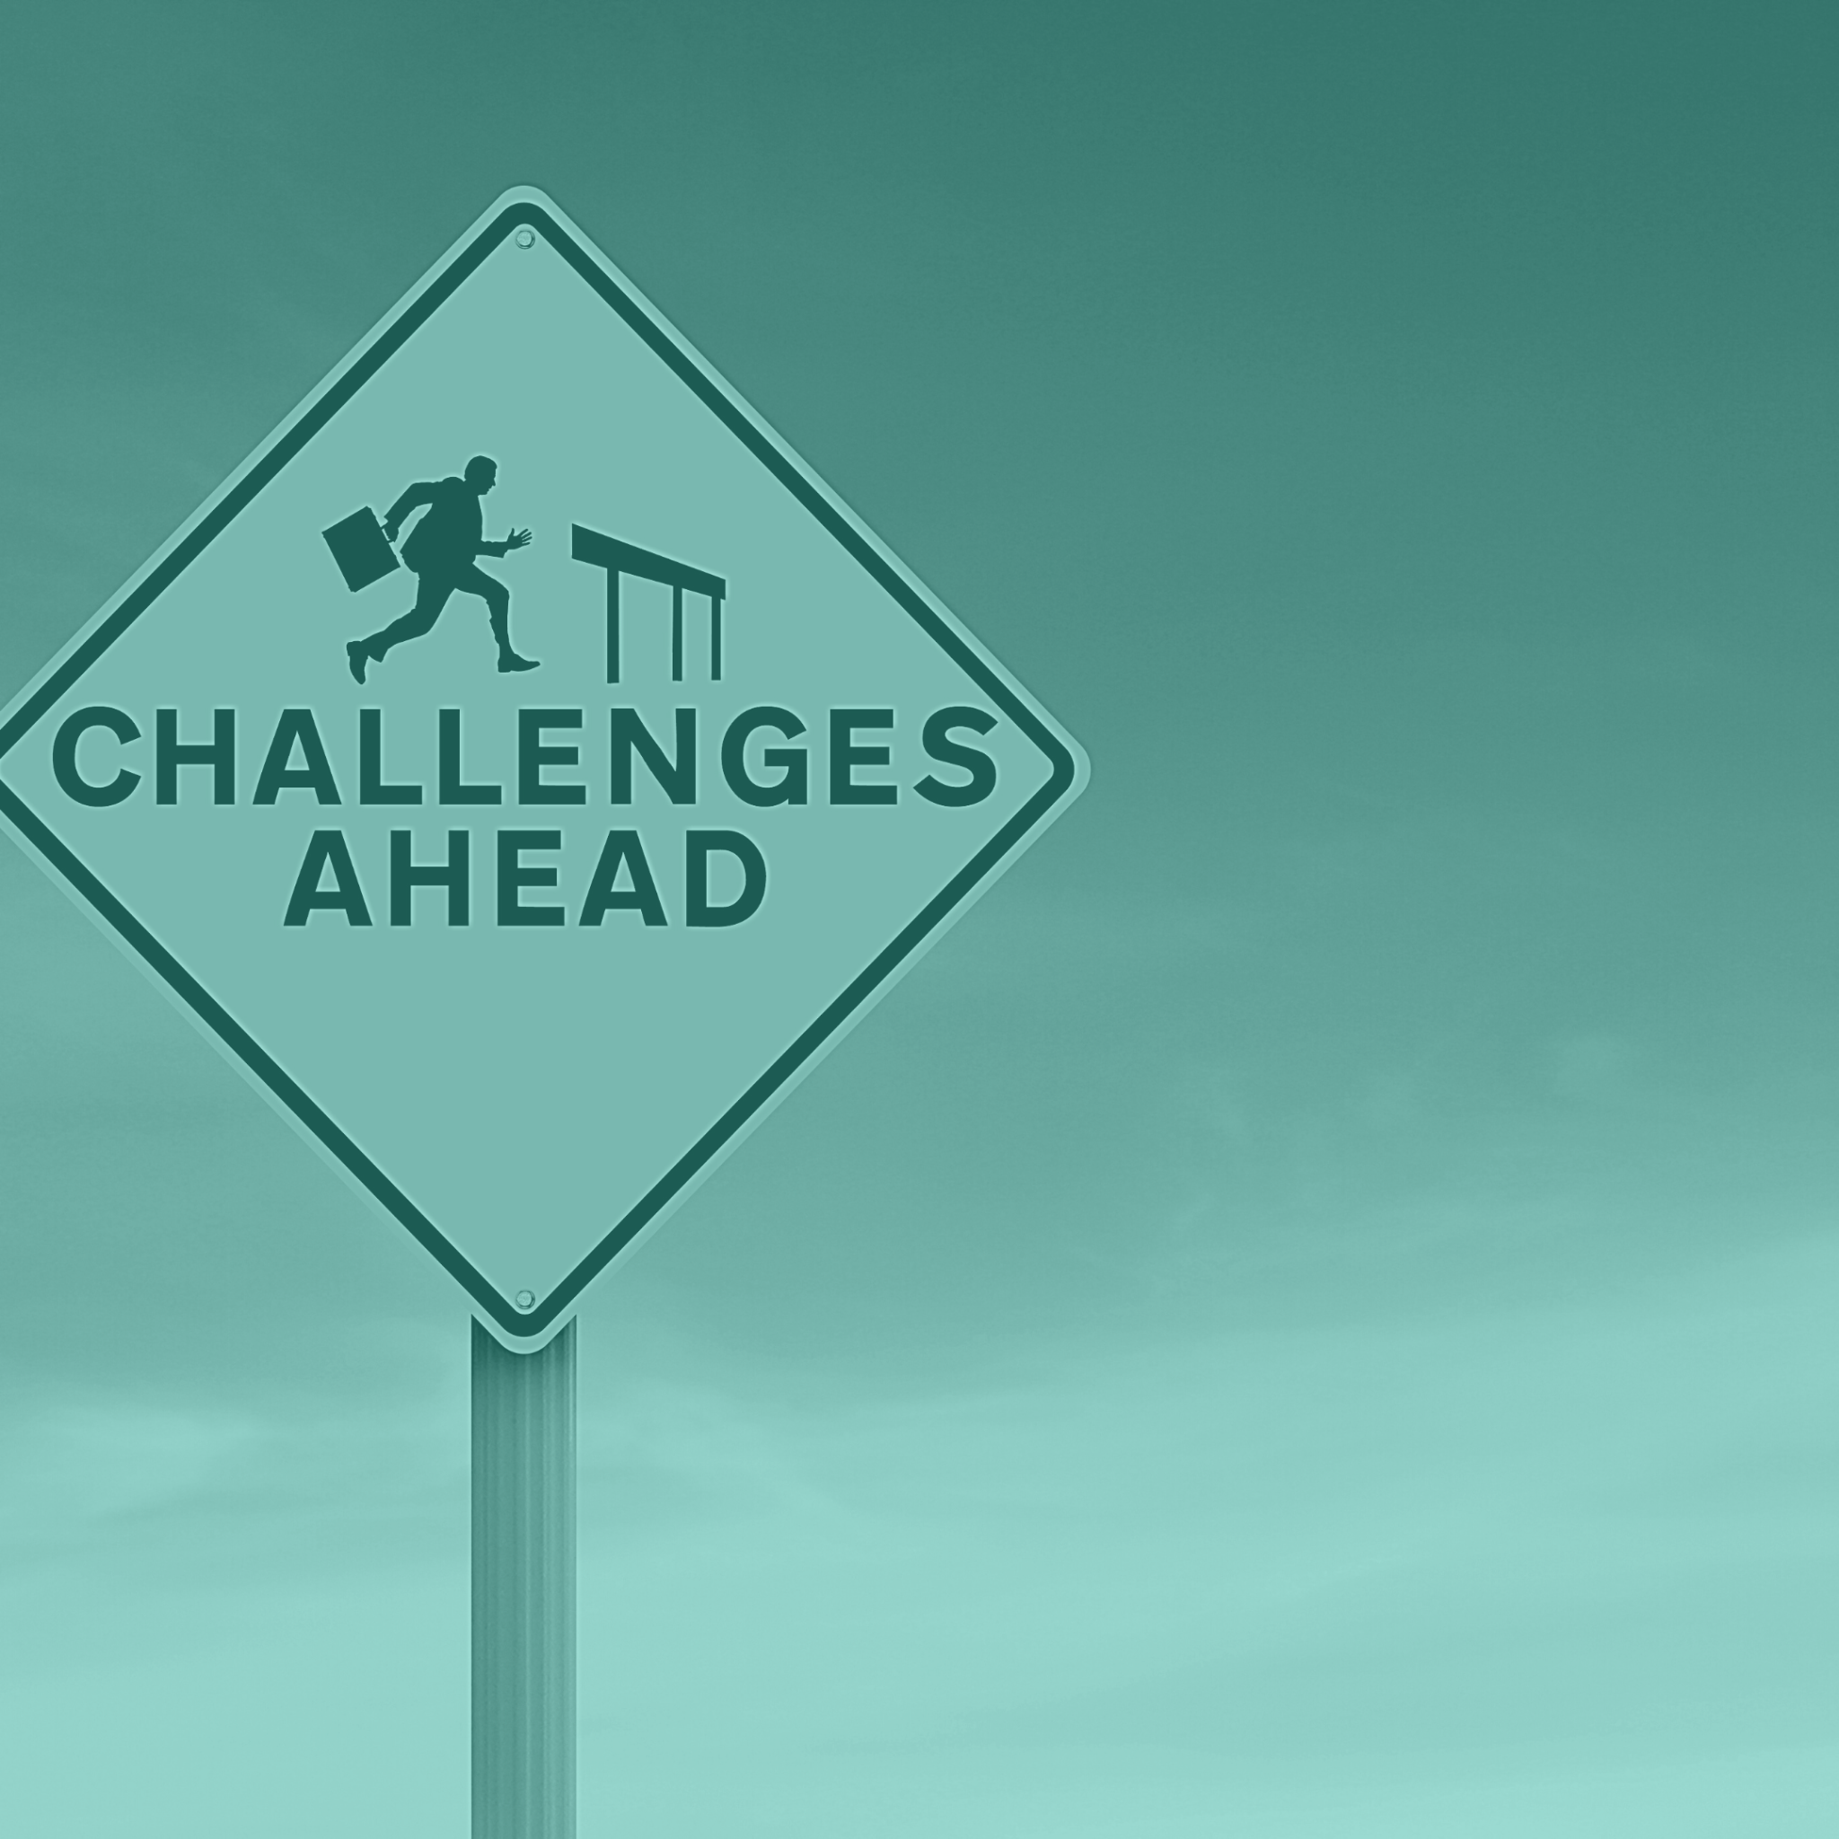
A new set of fair classification algorithms and their challenges
Classification algorithms can be modified to behave fairly.
However, they also present two challenges:
How to choose an appropriate definition of fairness?
What technique to use to incorporate fairness into a classifier?
Notes:
These issues of classifier discrimination sparked a lot of interdisciplinary research in developing “fair” classifiers- classifiers that recognise and behave fairly.
But this also presented two new challenges.
First, how do we choose an appropriate definition of fairness?
And second, what techniques should we use to include our chosen definition into a classifier?
Anna: This slide needs improvement. The title and the two bullet points are not super in sync. Also, try to make it a bit more visual. Are you talking about "challenges" here? You can go with "There are two challenges to ensure fairness, the first is to decide on an appropriate fairness notions... there are many existing... one needs to carefully choose which one is appropriate... and the second challenge is to incorporate that fairness notion into a classifier to enforce fairness ...." I would make the visuals to reflect "Challenges" and two boxes, appearing one after another.

Slide 6
How should one choose an appropriate
definition of fairness?
Notes:
So let’s discuss more about the first challenge, which is choosing the right definition of fairness
Anna: I am not sure if the title is fully correct. I would rephrase it something like Which fairness notion should we pick? This doesn't seem super catchy, but I'd go along this line, since we are not here to define fairness, rather help people choose the right definition of fairness among a bunch of different fairness notions.

Slide 7
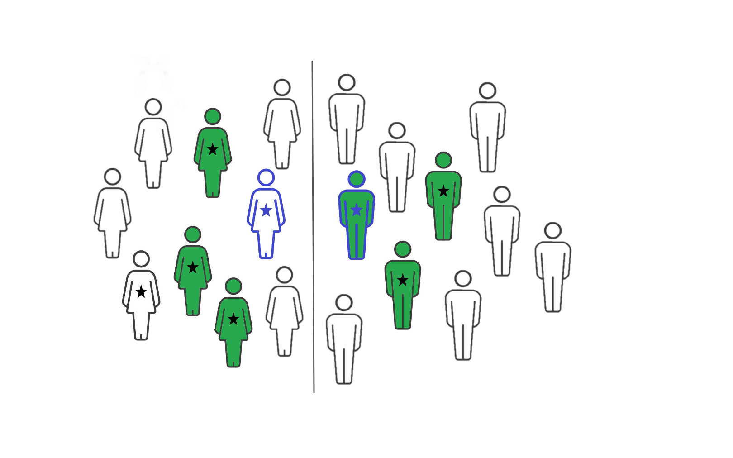
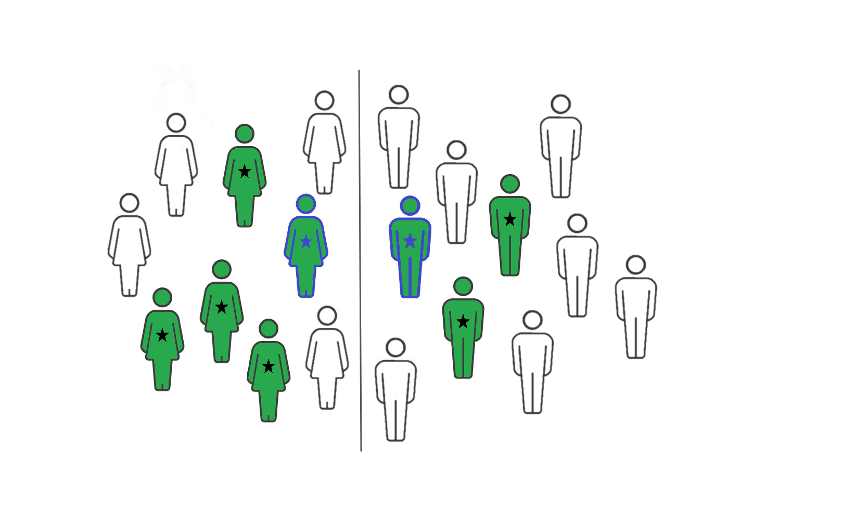
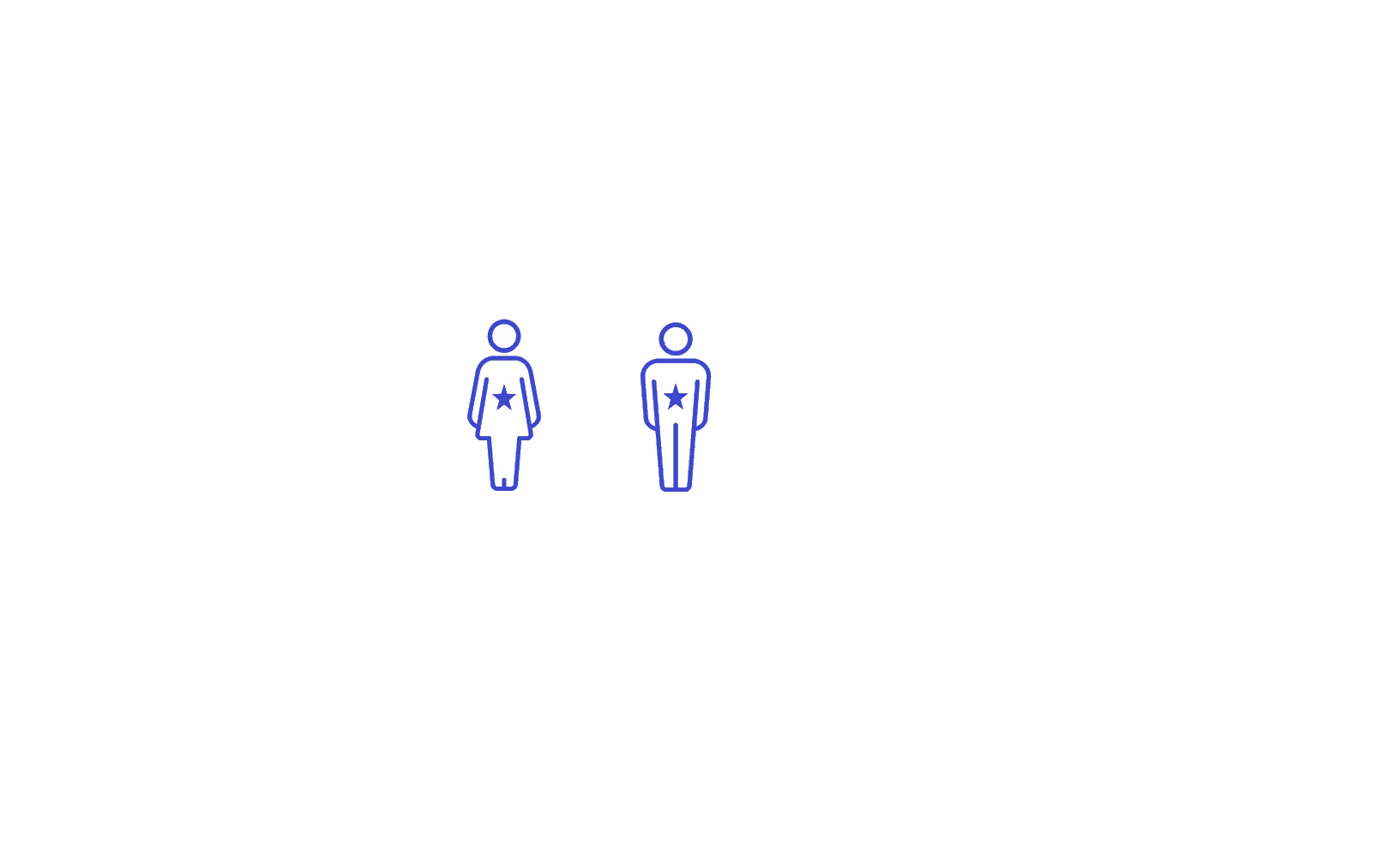
Fairness is subjective, non-trivial, and there is no one-size-fits-all definition
★ means qualified, Green means hired
Female
Male
Female
Male
Ava Leo
Ava and Leo are twins with similar qualifications
and they decided to apply to the same job…
If we ensure group-level fairness through equal gender representations…
Leo is hired but Ava is not!
Individual fairness ensures all similarly qualified individuals like Ava and Leo are hired.
Now gender representations are out of balance!
Notes:
Why is it difficult to choose the right notion of fairness?
Let’s see that with an example..
Let’s say Ava and Leo are twins with similar qualifications, and they applied to the same job.
Consider that we want to ensure all gender groups are treated fairly, so we hire each gender in equal proportions.
SInce there are only 3 qualified males, we hire everyone including Leo But… Ava is rejected because other females candidates are more qualified than her and we cannot hire more than 3 to keep gender balance
So even though Ava and Leo are similar, they are treated differently..
On the other hand, we can choose individual-level fairness and only care about similar individuals being similarly.
So Ava and Leo both get hired, along with others, but now equal gender representation is lost. So males as a group are under-represented.
This shows us that fairness can be defined from many angles, and they offer different guarantee.
[Anna: This needs to be elaborated more. Say that, suppose we want to ensure group fairness, that is, equal number of candidates are hired from each gender group. So if we want to hire 6, we will pick 3 male and 3 female, Ava stands 4th in terms of qualification among female, so this will result in Ava being rejected because there are three other female candidates more qualified than Ava. In contrast, Leo is the 3rd most qualified male, but combined, 7th (make it such that it makes sense). So Leo will be hired but not Ava… Overall, make it very concrete and spell the situation out to make it crystal clear. Don’t make it vague.]
Anna: Very much agree on Alexandra on this. This is a super interesting slide that would motivate people to understand why different notions of fairness is important. Give a tangible example, use names say mona and arash are twins with identical properties, but because mona is female, to ensure demographic parity, she might be treated differently than arash although they are identical... something like that.
AM: It would be really nice to focus this slide on an example. Give a simple intuitive (informal) definition of fairness (e.g., statistical parity), and then contrast it with another (e.g., individual fairness). Note that one is not clearly superior than the other, they just offer different perspectives. (it is not simply a matter of subjectivity, like which definition each person prefers).

Slide 8
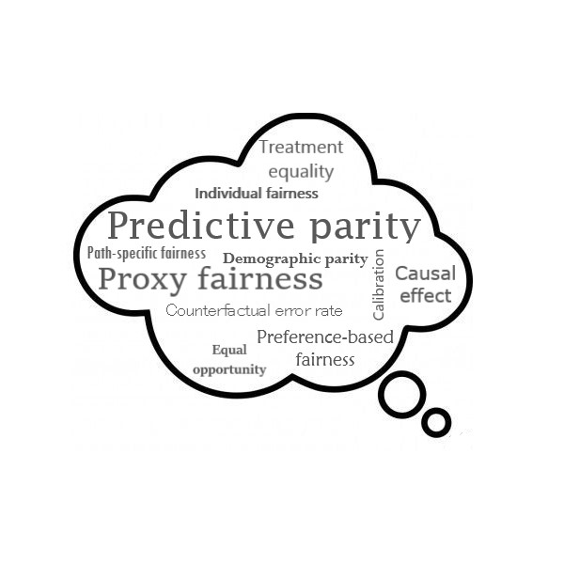




The explosion of fairness notions makes it very difficult to choose the right one
It is very hard to choose from so many options for fairness notions.
We organize notions for easy and informative comparison!
First Contribution
Notes:
Because fairness is so multidimensional in nature, there have been many many different definitions proposed in literature.
which makes it very hard to actually pick the right one without a systematic comparison
This brings us to the first contribution of our work:
we propose an informative categorization of fairness notions to easily compare among them
I would bring up your fairness table here, not to go over it right now, but just to show the audience that a LARGE number of fairness notions exist and it is a CHALLENGE to pick the right one. Or maybe show a word cloud of different fairness notions to "overwhelm" the audience that there are too many and we DO NEED proper categorization and systematic analysis over these notions.

Slide 9
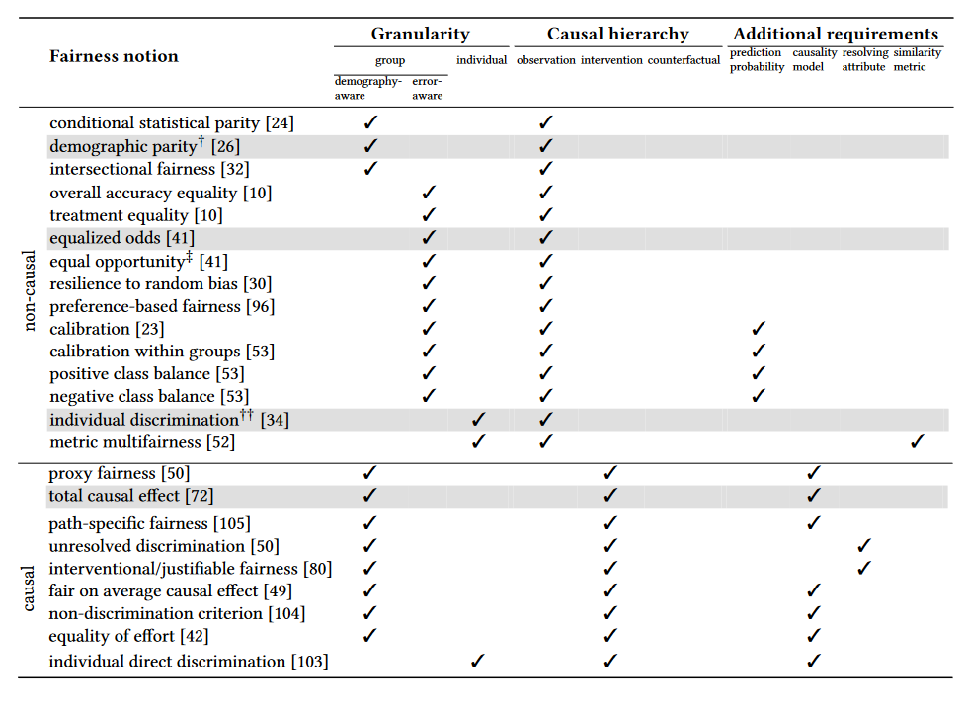
We propose an Informative categorization of fairness notions
Our categorization highlights practical concerns
What level of granularity do we care about?
Collective fairness for a group
Similar outcomes for similar individuals
Demographic parity between males and females
More details are in our paper…
Similar outcomes for Ava and Leo under individual fairness
Notes:
On the left is an example from our categorization of existing notions
Due to time constraints, I’ll just discuss one aspect of it
Our categorization makes it easy to compare many practical concerns. For example: what level of granularity do we care about in our target population?
Do we want to ensure a group is collectively treated fairly? Like males and females in our previous example. Or, do we care about what outcome each individual gets and ignore their group? Like Ava and Leo.
And there are many more practical questions like this that we can help answer. Please look at our paper for more details!
Anna: I would perhaps bring the figure from the paper and draw overlaying boxes on top of it to make the points here. You can use color coding to show classification across different dimensions. And also, as Alexandra pointed out, make it clear that it is our contribution.

Slide 10
Which technique should one use to
incorporate fairness within a classifier?
Notes:
Let us shift our attention to the second challenge now, which is picking the right technique to enforce fairness in a classifier
Anna: Again, like the previous comment on the other title, this too seems off to me. I would go with "Which fairness-enhancing classifier should I choose?" or "How different fairness-enhancing classifiers fare" etc. etc.
Basically I will distill out two key contributions early on: (1) we enable people to choose right notion of fairness and (2) we enable people to make an informed choice of classifier and understand their trade offs.

Slide 11
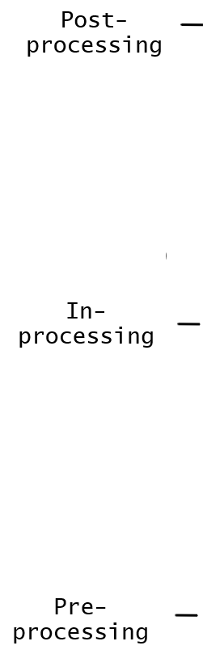
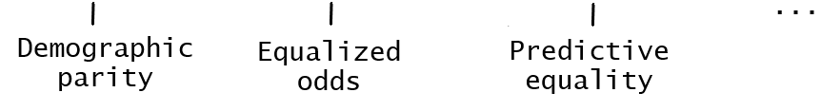
Fair classification approaches can vary across two dimensions
Stage of ML pipeline
Where to apply fairness notion?
Reject option
classifier (Kamiral et al.)
Equalized odds post-
processing (Hardt et al.)
Randomized post-
processing (Pleiss et al.)
and many more…
Fairness-
constraints (Zafar et al.)
Rich sub-group
fairness (Kearns et al.)
Adversarial
debiasing (Zhang et al.)
Meta-fair
algorithm (Celis et al.)
Seldonian classifier
(Thomas et al.)
Reweighing (Kamiran et al.)
Optimized pre-
processing (Calmon et al.)
Which fairness notion to target?
Fairness notion
Notes:
We can think of fair classifiers varying across two dimensions.
First, different classifiers have different fairness objectives, this is our choice of fairness notion from earlier.
Second, there are 3 main stages of the ML pipeline that we can choose to apply our chosen fairness.
Similar to before, these dimensions or choices have led to an explosion of fair classifiers in literature.
So now you might be wondering, what exactly are these stages?
Anna: Make it visual. Maybe put two axes (target notion on X and in/pre/post on Y) and draw points on the graph and encode them with color to visualize how different fair classifiers fall in different categories.

Slide 12
Fair classification techniques: pre-processing
Modifies data before training to remove biases
Notes:
Pre-processing is the stage before training/learning So a preprocessing technique modifies the training data to remove biases from it
Anna: I would add visual text here such as "Alters data to..." same is true for the next two slides. Just name-dropping saying in/pre/post is not enough, what the fundamentally do is important bit and try to highlight it within the slide.

Slide 13
Fair classification techniques: in-processing
Constrains a classifier’s objectives during training
Notes:
In-processing is the learning phase
Inprocessing techniques modify the learning algorithm to add fairness constraints

Slide 14
Fair classification techniques: post-processing
Modifies predictions after training to achieve fairness
Notes:
Post-processing is the last stage, where a learned classifier makes predictions.
Post-processing techniques modify the predictions to achieve target fairness.
AM: I like these 3 slides.

Slide 15

The tradeoffs among fair classification techniques are not well-studied
No detailed empirical study exists in literature.
We empirically analyze and compare the fair classifiers!
Second Contribution
Notes:
Each type of technique we discussed so far has different advantages.
But in existing literature, there is no empirical study that evaluates their tradeoffs
So we don’t really know how good/bad a technique is, compared to others in practice.
This is where our second and main contribution lies: we empirically investigate the variety of available techniques and make comparisons!
Anna : Start with the challenge (bullet 1, this may go as the title), then propose the solution (title), then highlight contribution (bullet 3).

Slide 16
We conduct a systematic analysis of fair classifiers from a practical standpoint
Evaluating broad range of 18 fair classifiers
7 variants of pre-processing
8 variants of in-processing
3 variants of post-processing
Evaluating broad range of 18 fair classifiers
7 variants of pre-processing
8 variants of in-processing
3 variants of post-processing
Utilizing 3 real-world datasets
with different biases
Adult: 45K #datapoints, 9 attributes gender inequality in annual income
COMPAS: 7.2K #datapoints, 3 attributes racial bias in detecting recidivism
German: 1K #datapoints, 9 attributes
gender bias in assessing credit worthiness
Utilizing 3 real-world datasets
with different biases
Adult #datapoints: 45K
gender based income inequality
COMPAS #datapoints: 7.2K
racial bias in detecting recidivism
German #datapoints: 1K gender bias in assessing credit worthiness
Examining practical concerns
for data management community
How much correctness do classifiers trade off while enforcing fairness?
How efficient and scalable the approaches are, especially when data grows vertically/horizontally?
Does the choice of ML model matter for pre- and post-processing?
What happens if the training data has errors?
Notes:
We chose 18 techniques that span the 3 stages and cover a variety of notions.
We examined their behavior on real-world datasets representing gender and racial biases.
And we asked relevant, data management centric questions. Such as.. To ensure fairness, do classifiers sacrifice the accuracy of their predictions?
Are all techniques equally scalable?
What happens if training data is noisy? …and so on and so forth
Anna: I would use three separate slides for this, or fade parts that you aren't talking about so that the audience focus on only one box at a time. This can be made more visual as well. Also, put some data stat (e.g., #data points) for each dataset and some info (income data, credit data, recidivism data etc.)
The first box can be made more visual. You can think of some visuals to represent in/pre/post and use that throughout the ppt.
The last box looks like name-dropping to me. I would pose it as asking questions such as "To ensure fairness, how much correctness the classifiers trade off", "Are all fair approaches equally scalable? How do they compare when data size grows both vertically and horizontally", "What if my training data has errors?", "Does the performance depend on the chosen model"... so by posing these questions, you make the audience curious about your results. Name dropping like this makes it look rather "boring" and doesn't motivate people WHY they should care.

Slide 17

What did we observe in our experiments?
Notes:
By now, you must be wondering what interesting insights we have. Let’s dive right into it!

Slide 18
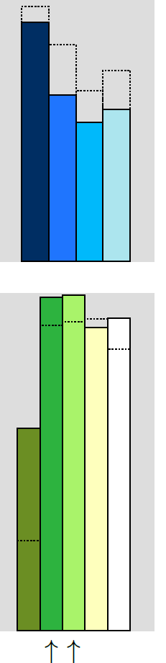
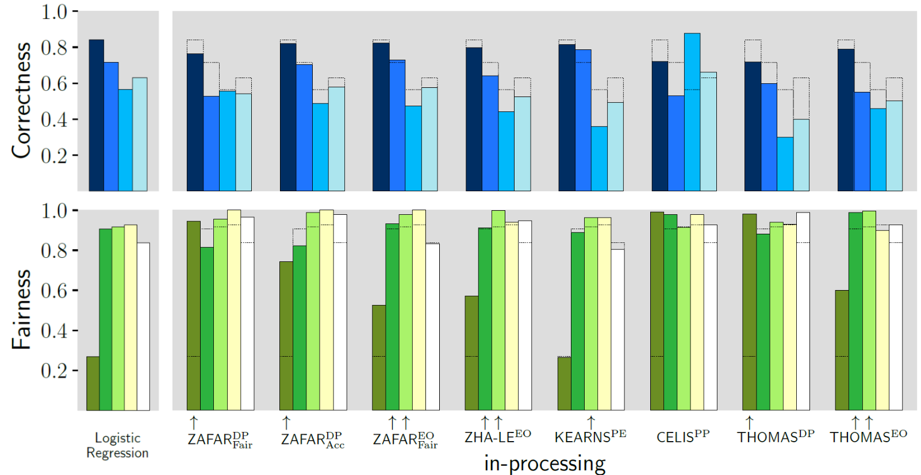
Correctness and fairness tradeoff
A variety of
correctness and fairness metrics
Fair approaches trade accuracy
for fairness
Notes:
[Maliha: I removed red /// patterns from the bars. They were used to represent reverse discrimination/fairness in the paper. It’s too much to look at and we don’t even discuss it here.] The first thing we looked at is the potential tradeoffs of enforcing fairness. We measured the correctness and fairness of predictions through a variety of metrics. The correctness metrics, such as accuracy, are depicted in the top half of the figure. We have different fair classifiers on the x-axis and their corresponding correctness on the y-axis. The bottom half of the figure is similarly designed for the fairness metrics. We also establish a baseline by comparing with a vanilla, fairness-oblivious classifier. This baseline is overlaid on each fair classifier, so we can compare what changes happen in a fair classifier.
The first thing we notice is that, fair approaches compromise accuracy, as evident from the gap in each bar and its overlay. Classifiers typically target maximizing accuracy as their objective. Fair approaches, directly or indirectly, modify this objective to target both fairness and accuracy. The compromise we see is a natural consequence.
Anna: I simplified the title a little bit. You can do the same for the other slides. In general, the less text are there in the slides, the better. Because when someone is reading your slides, they will lose attention to your narration and you don't want that. Also, while speaking, first give enough context to the audience. What X-axis denotes, what Y-Axis denotes, what different colors and shades denote, what the extra rectangles (to show gaps) denote. What the top part denotes, what the bottom part denotes. The thing is you know what this graph is all about, but someone might be completely clueless. So spend enough time to "Familiarize" them with the legend/color coding etc. of the plot first. Then talk about the take aways. Do not rush this slide. This is one of the important slides. Once this slide is clearly done, then you can go faster for the remaining of the slides.
No need to flash the other graph at the end. Just say what other results are in the paper (maybe bring back some content from Slide 16) and mention that those are in the paper. But DO spend a lot of time in explaining this slide better. I would zoom in to the relevant part. Take a look at the slide I referred to you over email, from one of my talks.
You make two points here, so I will use two different slides and communicate it very clearly.

Slide 19
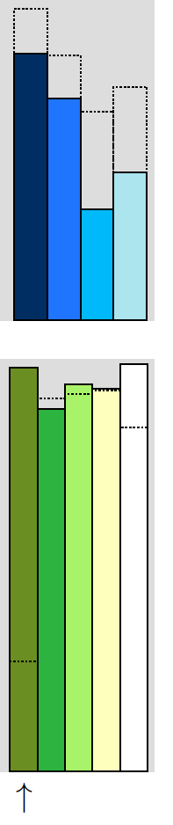
Correctness and fairness tradeoff
A variety of
correctness and fairness metrics
Bigger compromise in accuracy if target fairness is low in a fairness- unaware classifier
Notes:
We also find that the compromise is bigger if the target fairness is very low in the baseline. This is because a fair classifier has to significantly change the predictions in such situations, to achieve the desired amount of fairness.

Slide 20
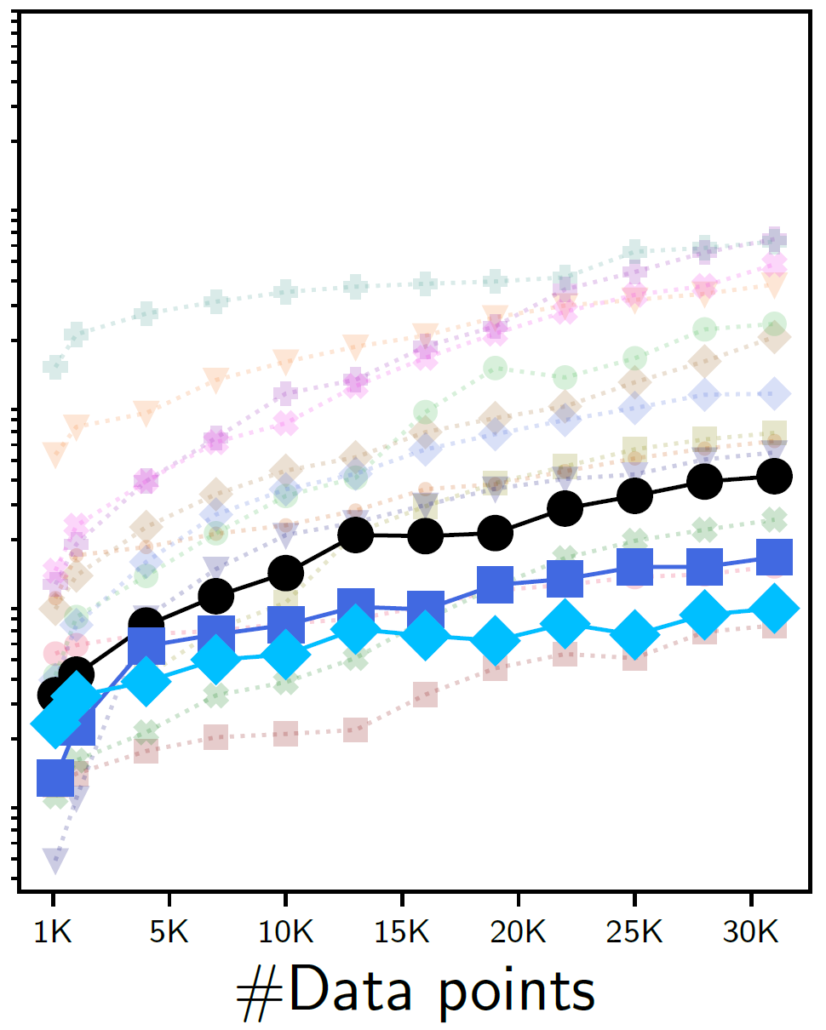
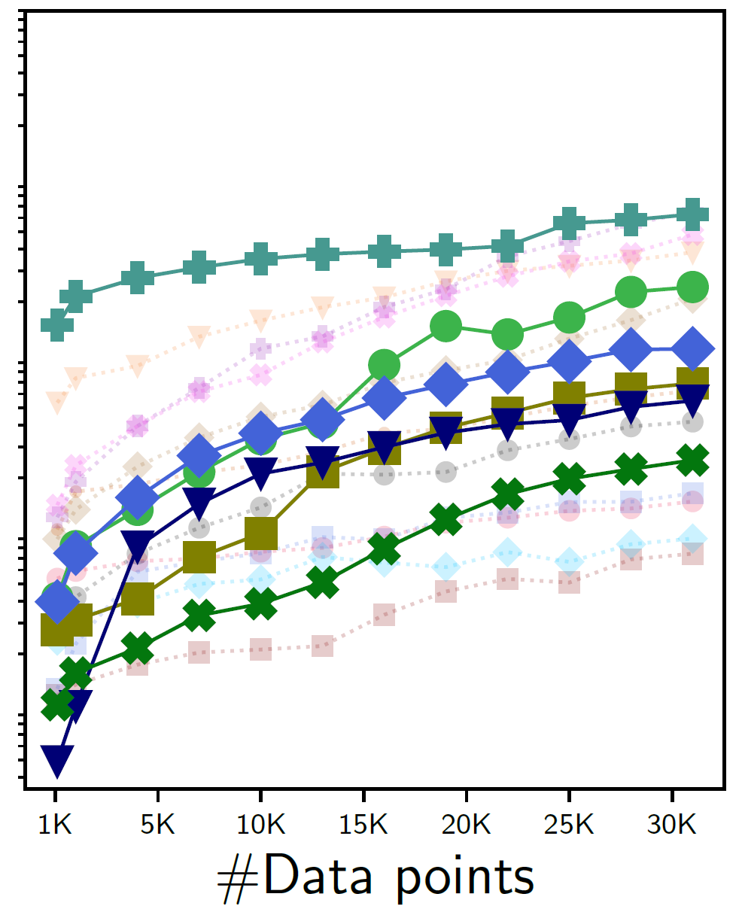
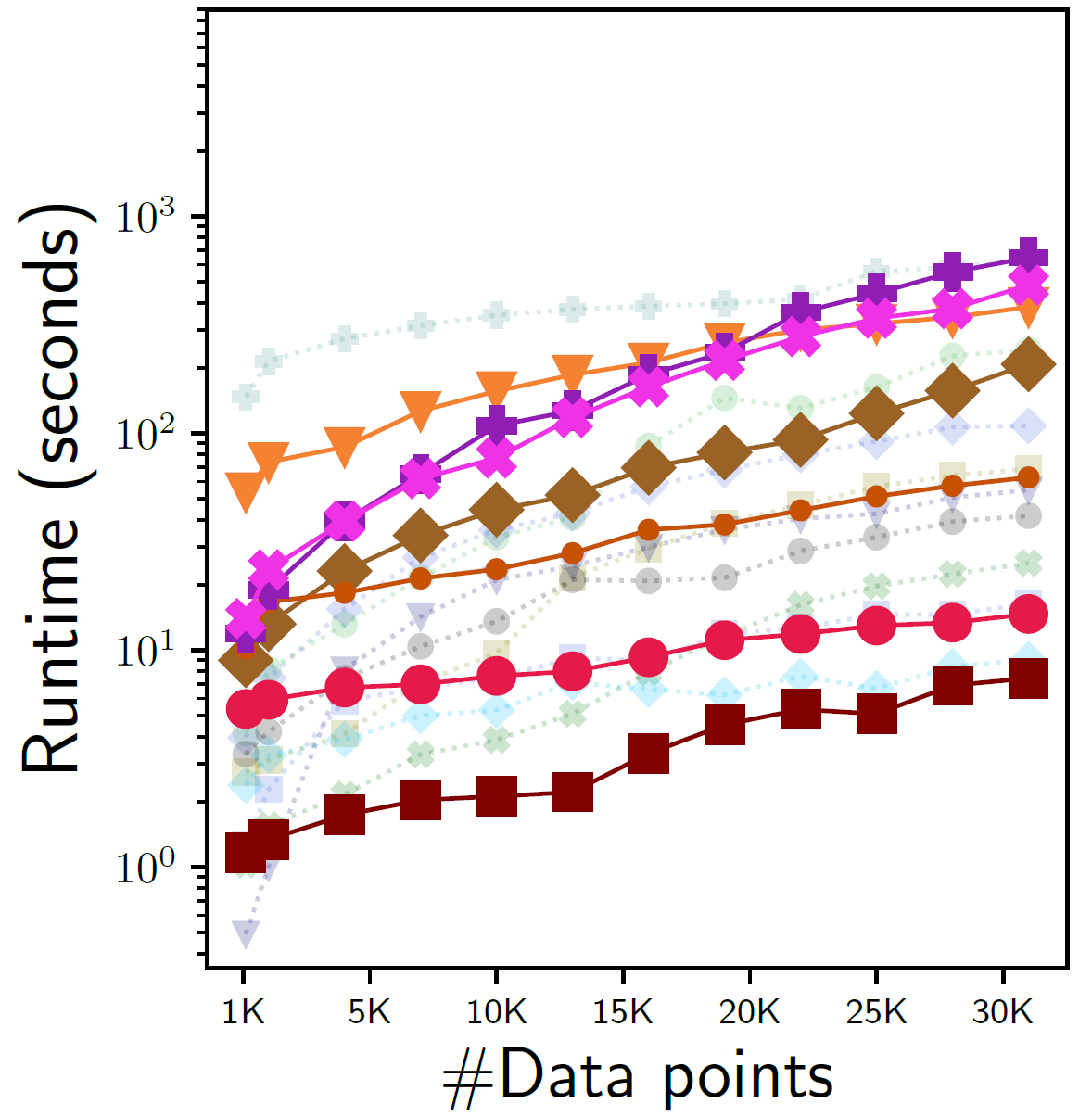
Efficiency gap among techniques: how increasing #datapoints affect runtime?
Post-processing are most efficient due to inherent simplicity
Pre-processing
In-processing
Post-processing
Notes:
Next, let’s look at how the approaches fared in our scalability tests.
We measured the runtime of each approach with increasing number of training datapoints. In the figure, we have number of data points on the x-axis and the runtime on the y-axis. Our findings suggest that post-processing is the most scalable. Post-processing happens at a very late stage and only modifies the predictions on the fly. This is hardly affected by size of training data.
Anna: I think this is something you can highlight more given it is SIGMOD audience. They care a LOT about scalability and efficiency.
Agreed. Just show a few or a general trend. You can draw some new plots just enough to highlight your takeaway. Then you can always "Flash" the actual plot but do not spend too much time there since you don't want the audience to try to actually read it :)
AM: Again there are a lot of graphs in one slide and the audience will have a hard time. At least show the first set of graphs (# data points) first, help the audience digest those, and then show the others.

Slide 21
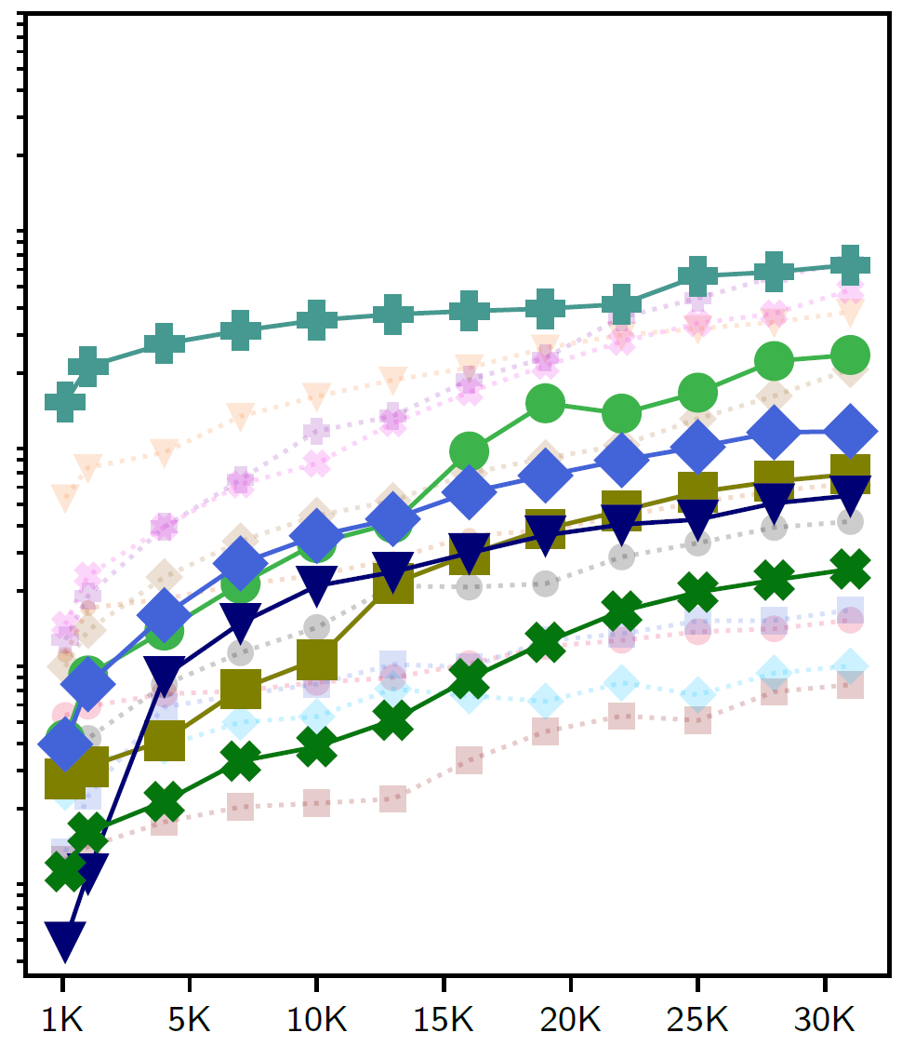
Efficiency gap among techniques: how increasing #datapoints affect runtime?
Complex mechanisms can lower efficiency, commonly observed in pre- and in-processing
Pre-processing
In-processing
Post-processing
Notes:
Pre- and in-processing have more involved mechanisms to repair data or retrain model, which can lower efficiency.

Slide 22
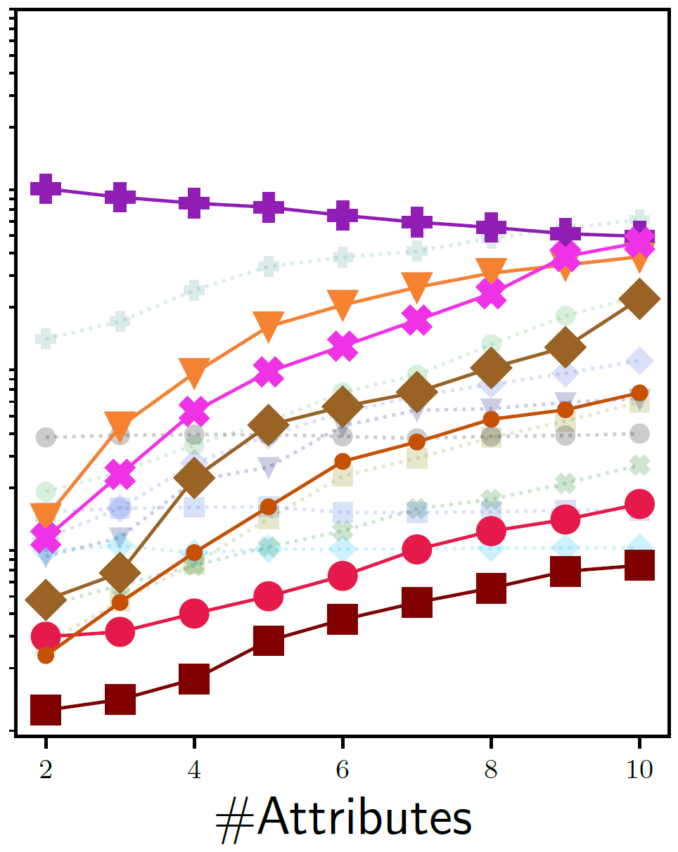
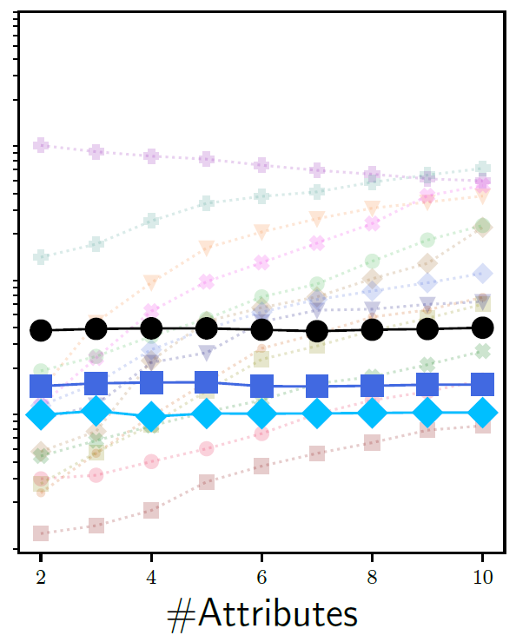
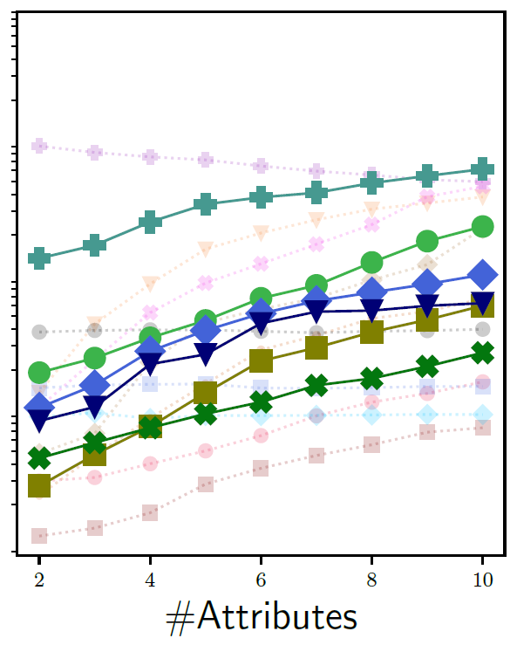
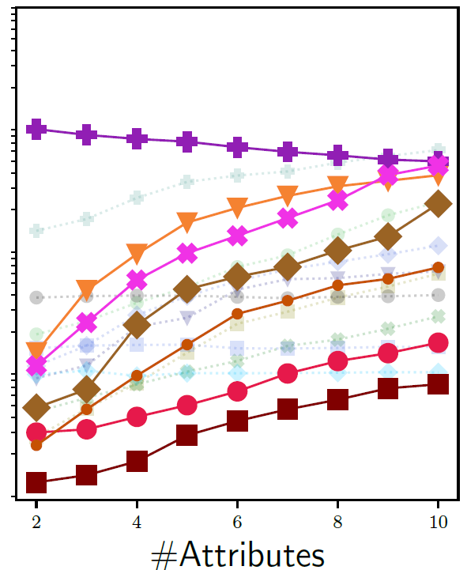
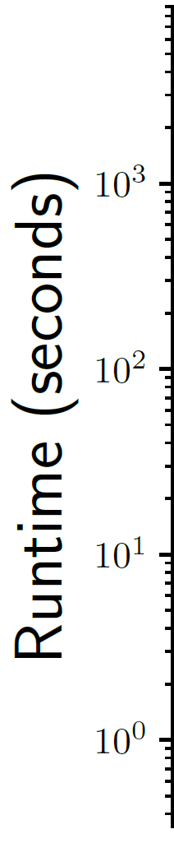
Scalability challenges in pre-processing: how increasing #attributes affect runtime?
Scalability of pre- processing is more hurt by #attributes than #datapoints
Pre-processing
In-processing
Post-processing
Notes:
We also did another scalability test, where we measured the runtime of each approach with increasing number of data attributes. We find pre-processing often exhibits scalability issues. The runtime increases rapidly when pre-processing approaches do complex repairs per attribute.
This was also observed in in-processing but less prominently.
Anna: I think this is something you can highlight more given it is SIGMOD audience. They care a LOT about scalability and efficiency.
Agreed. Just show a few or a general trend. You can draw some new plots just enough to highlight your takeaway. Then you can always "Flash" the actual plot but do not spend too much time there since you don't want the audience to try to actually read it :)
AM: Again there are a lot of graphs in one slide and the audience will have a hard time. At least show the first set of graphs (# data points) first, help the audience digest those, and then show the others.

Slide 23
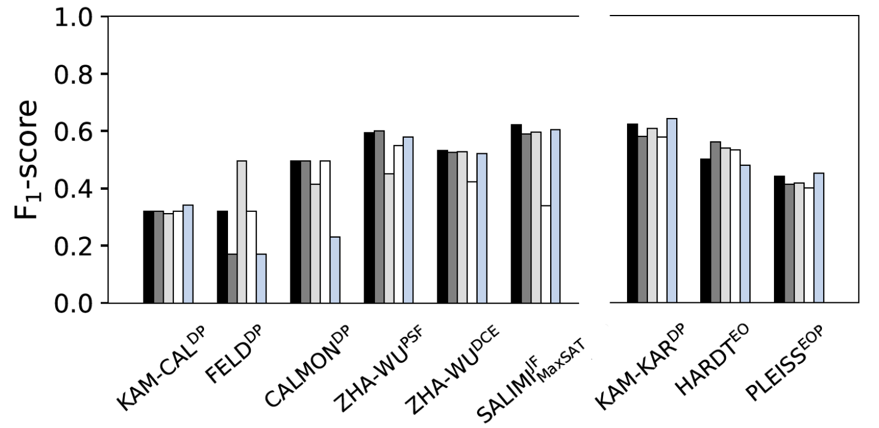
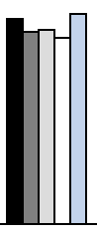
The choice of classifier model for pre- and post-processing
We retrain classifiers with different models
Post-processing is stable as it only modifies predictions after training
Pre-processing
Post-processing
Notes:
[Maliha: I chose to focus on this experiment instead of the data errors one. I agree that robustness to data errors needs a lot of assumptions explained and I don’t think I’d be able to cover enough background on it in given time.]
Pre- and post-processing happen before and after model training. These approaches are considered model agnostic because they don’t depend on the specific classifier model used. So we decided to test whether the choice of model has any effect on the techniques. We’ll briefly touch on some interesting findings due to limited time. Similar to before, x-axis represents each classifier and y-axis denotes F1-score, a correctness metric. Predictably, we found that post-processing remains unaffected, because it modifies predictions on top of the classifier.

Slide 24
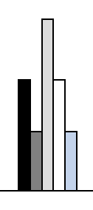
The choice of classifier model for pre- and post-processing
We retrain classifiers with different models
Pre-processing
can fluctuate depending on model
Pre-processing
Post-processing
Notes:
On the other hand, pre-processing has no control over how the repaired data affects a classifier model and can cause varied performance across different techniques.

Slide 25
Our paper has many more interesting insights
Evaluating broad range of 18 fair classifiers
7 variants of pre-processing
8 variants of in-processing
3 variants of post-processing
Utilizing 3 real-world datasets
with different biases
Adult #datapoints: 45K
gender based income inequality
COMPAS #datapoints: 7.2K
racial bias in detecting recidivism
German #datapoints: 1K gender bias in assessing credit worthiness
Examining practical concerns
for data management community
How much correctness do classifiers trade off while enforcing fairness?
Are all approaches efficient and scalable, especially when data grows vertically/horizontally?
Does the choice of ML model matter for pre- and post-processing?
What happens if my training data has errors?
Pre- and in- processing can fail to build fair models if training
data has errors
Notes:
There are many other observations we make from our experiments. For example, we also found that pre- and in-processing approaches can fail to build fair models if the training data has significant amount of errors. Please take a look at our paper for many more interesting insights like this!

Slide 26
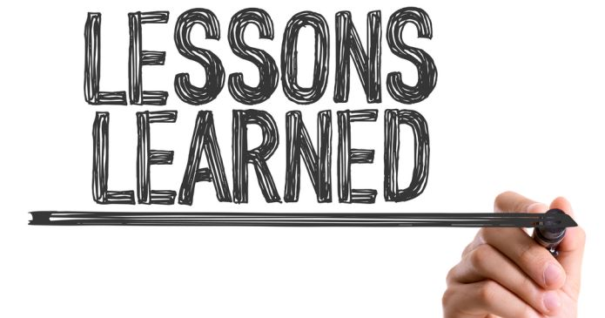
What did we learn from our experience?
Pre-processing presents immense opportunity for data
management research, especially in tackling scalability
challenges we observed
Effort into combining fairness concerns with data
cleaning can give pre-processing practical advantages
There is huge potential for synergy with ML research in
addressing scalability issues or optimal model choices
Notes:
To summarize: Our work is an empirical evaluation of fair classification techniques. To the best of our knowledge, this is the first wide-scale study to conduct such experiments from a DM-centric view.
I’ll finish off with 3 most important lessons that I think will be beneficial.
First, pre-processing techniques of data manipulation are a natural fit for the data management community. But they also present scalability challenges like we observed. This creates a unique opportunity as tackling scalability challenges is a strength of data management research.
Second, we briefly saw that data errors can cause fair models to fail. So there is a good opportunity to integrate fairness concerns into data cleaning methods, which is again a particular strength of data management research. This can give pre-processing an edge in practical settings.
Third, there is a lot of untapped potential for synergy with ML research, to combine the best of both worlds in handling scalability issues, picking the best/optimal downstream model, etc.
With that, I’d like to conclude my talk. I hope you'll read our paper for more in-depth analysis.
Do not say anything "Our community", a conference is global and people from different domains will be there. Be specific such as "Data-management community". Although, I don't like the statement. Maybe you mean "Data-management community has more responsibility/scope to contribute to the pre-processing techniques"?
The lessons learned here are quite vague and doesn't give much insight. Can you improve it? You can highlight some of the points you mentioned in earlier slides (e.g., post processing is more scalable and stuff like that). Whatever is mentioned in this slide, those are kind of obvious and one doesn't need this massive empirical evaluation to conclude to these points. So try to make it more interesting, and "quantitative", like those can only be gained through this effort of empirical study.

